Slide 1
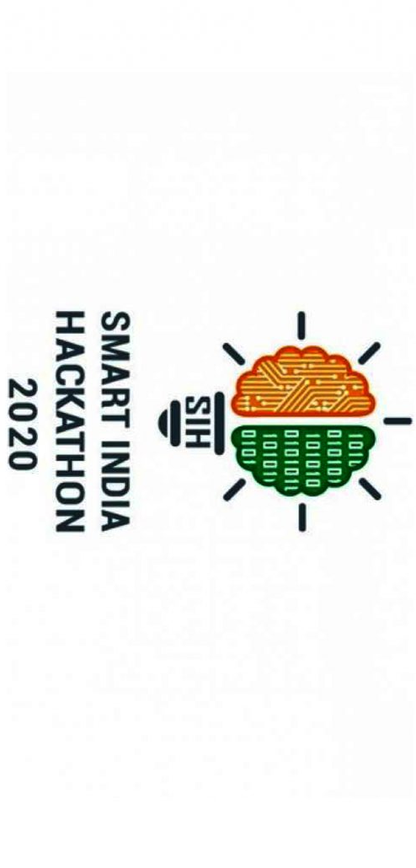
PRESENTED BY :-
TEAM TAKSHASHELA
BHARATI VIDYAPEETH’S COLLEGE OF ENGINEERING, LAVALE

Slide 2
PROBLEM STATEMENT
The objective of our team is to develop a software solution to predict the future jobs based on location, sector, package and eligibility. Big data analysis can be useful to collect and analyze the data from different job sites and predict the future requirement applying machine learning.

Slide 3
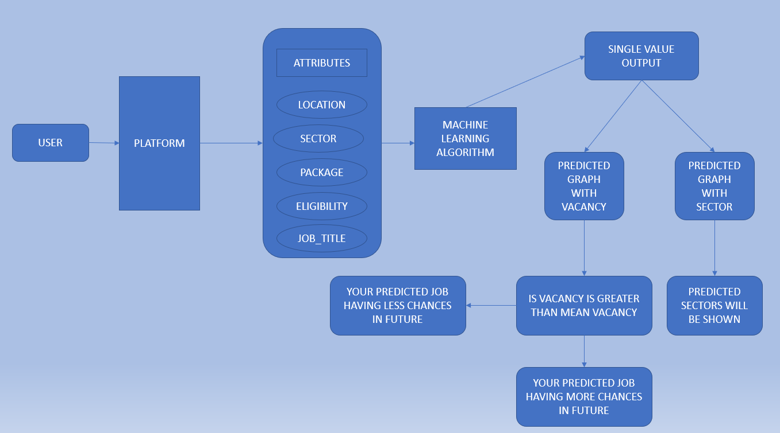
ARCHITECTURAL DIAGRAM

Slide 4
BACKEND DEVELOPMENT
The initial and the biggest challenge for us, was to find the data that replicates the real world scenario of jobs as the data was not provided to us by the customer, for which we explored the web like baggle but was unsuccessful to fulfill the need of the problem statement requirement.
Then, we explored many websites with the help of tool such as Dataminer and created a dataset by cleaning it using numpy and panda libraries that achieved what the problem statement desires.
We have even implemented various machine learning algorithms after which we have framed XGboost and Random forest with good score, so, we further narrow it down to RMSE values. As, the RMSE value gives better accuracy so we choose XGboost as our final algorithm due to its low RMSE values.
Till now we have executed XGboost algorithm on our dataset which gives various predictions and a good accuracy score.
We have also executed the graphs between the predicted values with other attributes to find the variance.

Slide 5
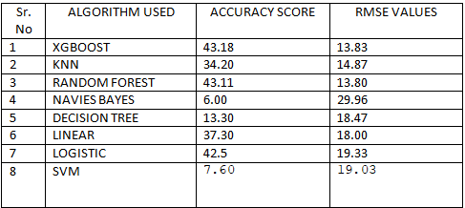
The technologies we have used till now are Sklearn for feature attraction and
algorithms, Matplotlib notebook for plotting, Numpy and Pandas for data
framing, MySQL for the database and for prototyping we have used Jupyter
Notebook. We are further working on flask for connectivity and security.
While working on the algorithms we found that the string has to be converted into numeric values as ML accept better accuracy to it. So, we converted it into labels by using Label Encoding.
Since one attribute named Eligibility was having an issue with it so we weren’t able to use Label Encoding, as each data in that particular cell has to separate it, so we used Count Vectorizer technique, which segregates each cell. After it, we got better results while working with the algorithms.
We have worked on different algorithms and find out the accuracy scores and RMSE values, the table will show the outcomes: -

Slide 6
For more classification we go to insights and checked the learning curves with gives us better knowledge about with algorithm to apply in our project.
We also plotted the graphs of the current data after training the model which other attributes which will help for the user to know for better approach.
We have worked on the prediction graphs which will give better idea for the future jobs in respect with vacancy as well as sectors.
We have worked on the connectivity through flask.

Slide 7
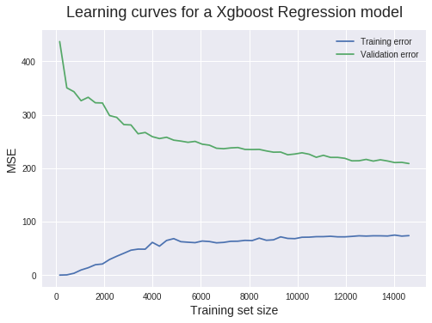
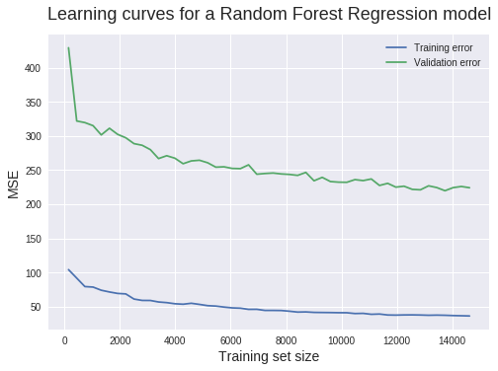
LEARNING CURVES OF ALGORITHM
XGBoost
RANDOM FOREST

Slide 8
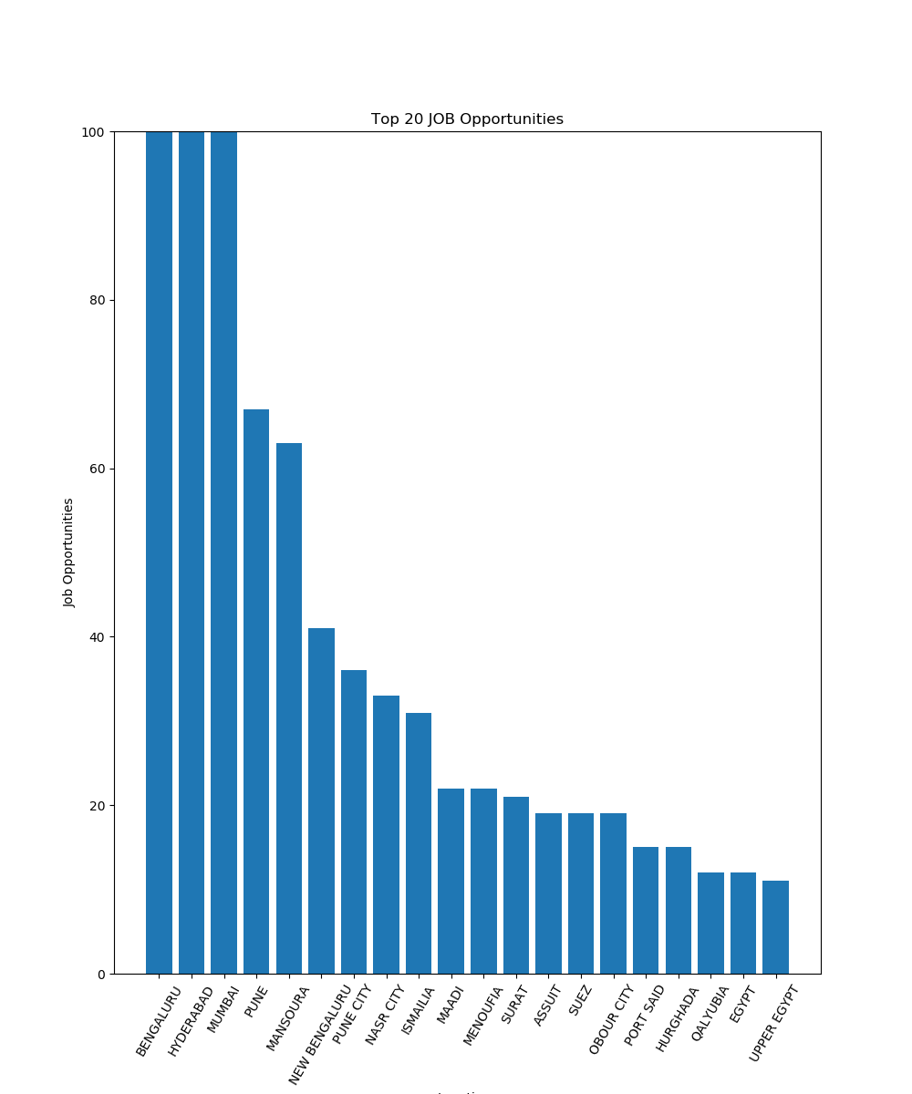
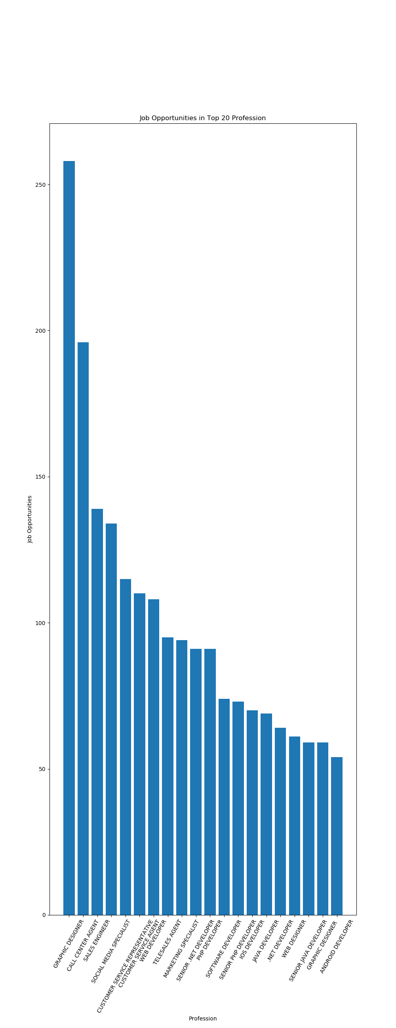
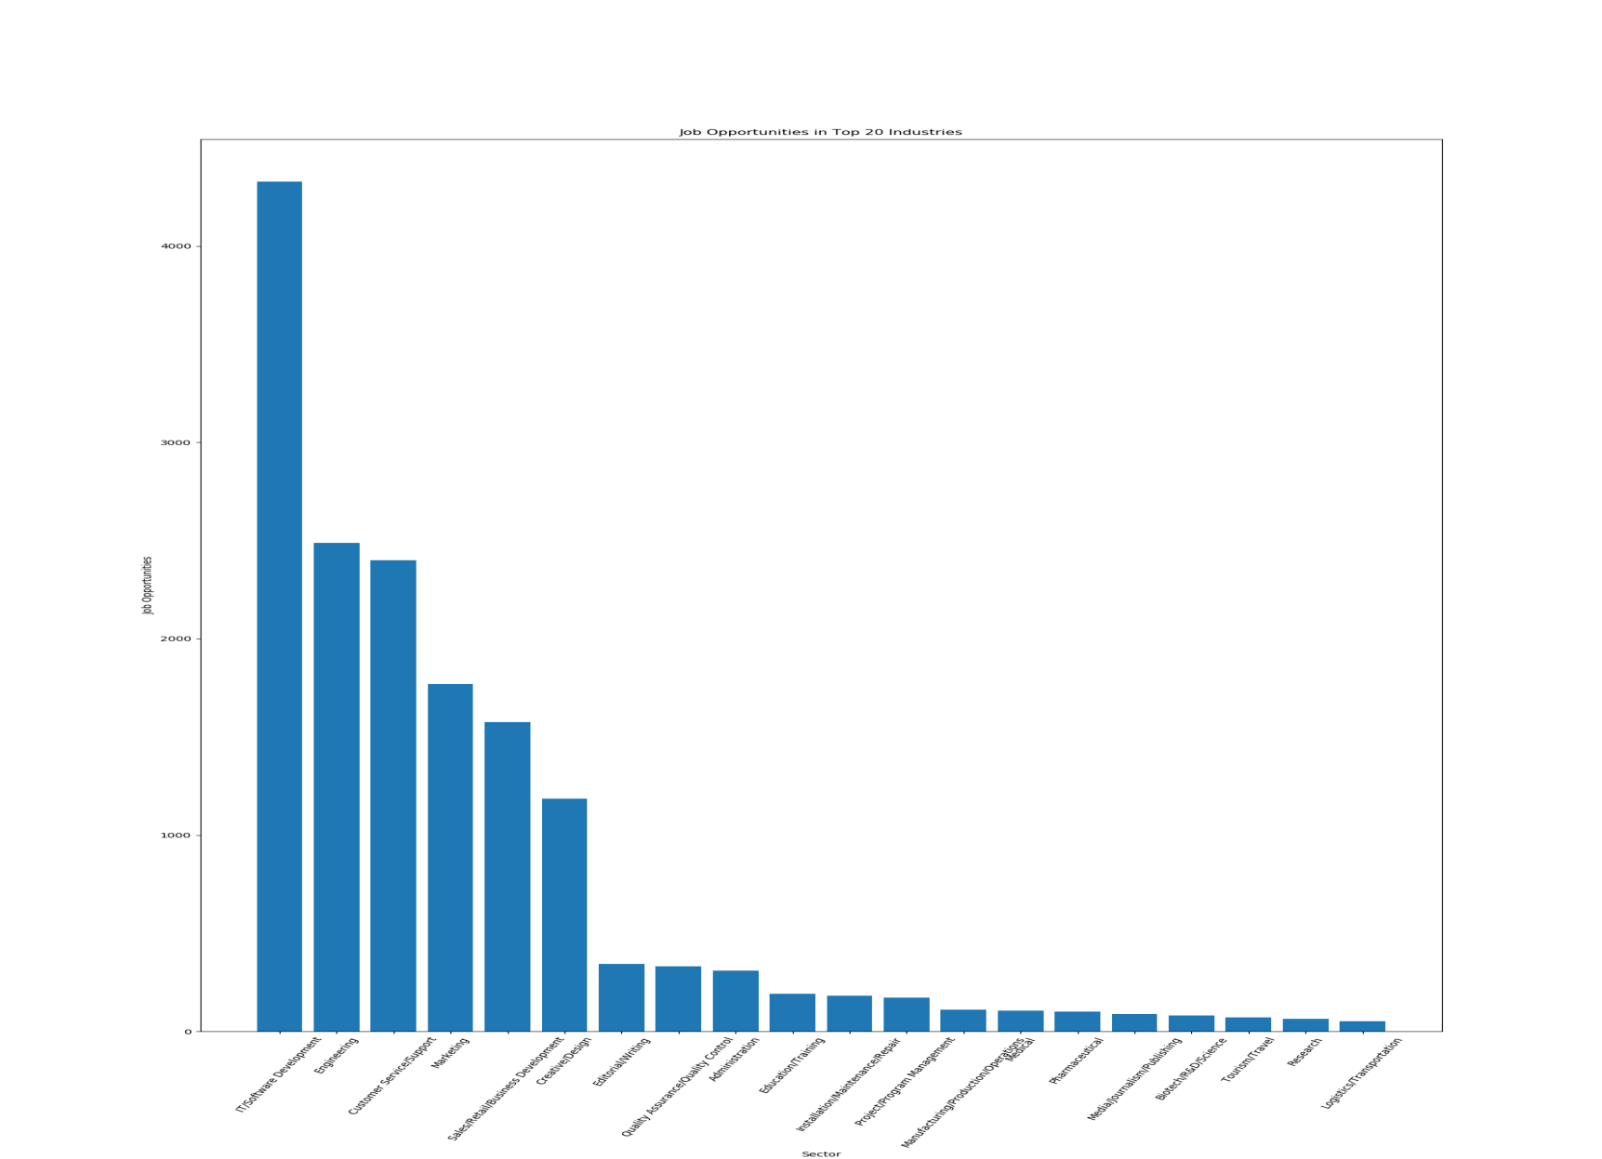
CURRENT DATA PLOTTING AGAINST VARIOUS ATTRIBUTES AFTER TRAINING THE MODEL
LOCATION - VACANCY
PROFESSION - VACANCY
SECTOR - VACANCY

Slide 9
FRONTEND DEVELOPMENT
The execution of the project started with the index page which the user will visit it first.
So, firstly the user needs to login or signup to our website in order to get the desired job prediction.
For that we have provided them login, signup and trending graphs buttons in header section.
So after successful login the user will be redirected to the home page of the website, in which we will take input from him through simple dropdowns. This dropdowns are like education, job title, sector, city and salary expectations. After filling this form the data will be sent to the prediction algorithm and the corresponding output will be shown.
We have used frontend technologies such as HTML5, CSS3 and Bootstrap for designing the web pages. We also used Flask which is a python framework for the connectivity of the backend and frontend.

Slide 10
We tried to keep the design of the website simple and easy to handle for the end user.
We have provided the proper buttons and links so that the user can go back and forth easily.
We also given description about each and every trend which helps the user to look closely to what he wants to search for, and helps to find the required job very easily.
We have predicted sectors after the requirements given to us by the user, which helps the user to know whether his/her sector will be in demand in future.

Slide 11
FRONTEND WITH FLASK
We have connected our index, signup, login and other html pages with flask framework.
In signup page all the credentials will save in MySQL database.
We have use SQLAlchemy for connectivity with databases.
In login page credentials we fulfil all the criteria which will redirect to the main page and if not, message will be flashed with wrong credentials.
The credentials will be extracted from MySQL database to check if it is correct.
We are developing our main page which will take various inputs which will be processed with the backend connectivity.
We are also working on the result page where we will show the predicted out with different functions.

Slide 12
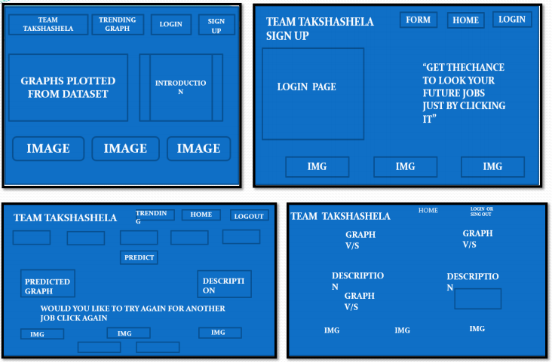
WIREFRAME

Slide 13
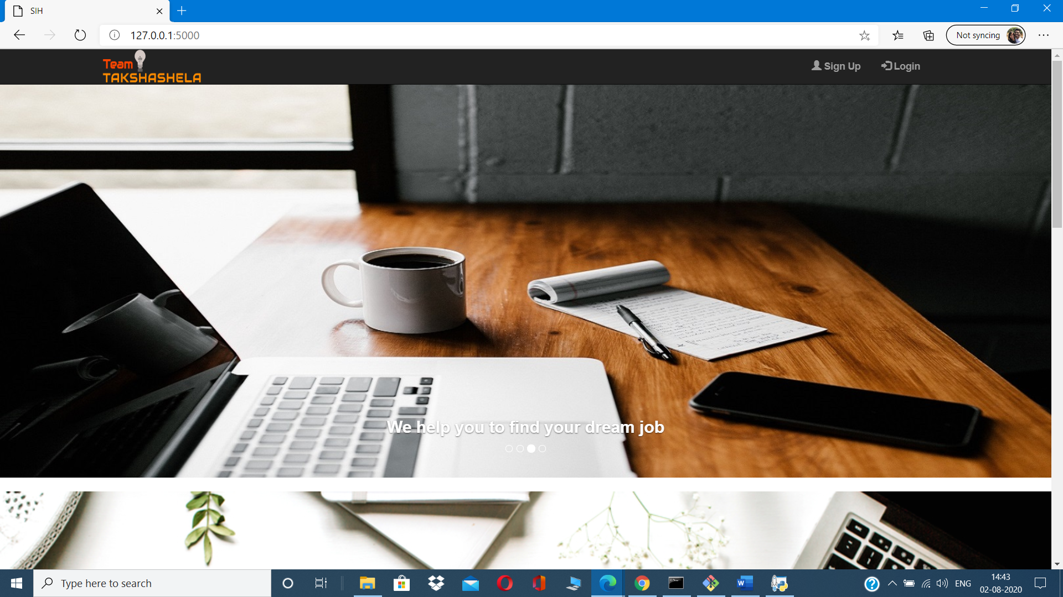
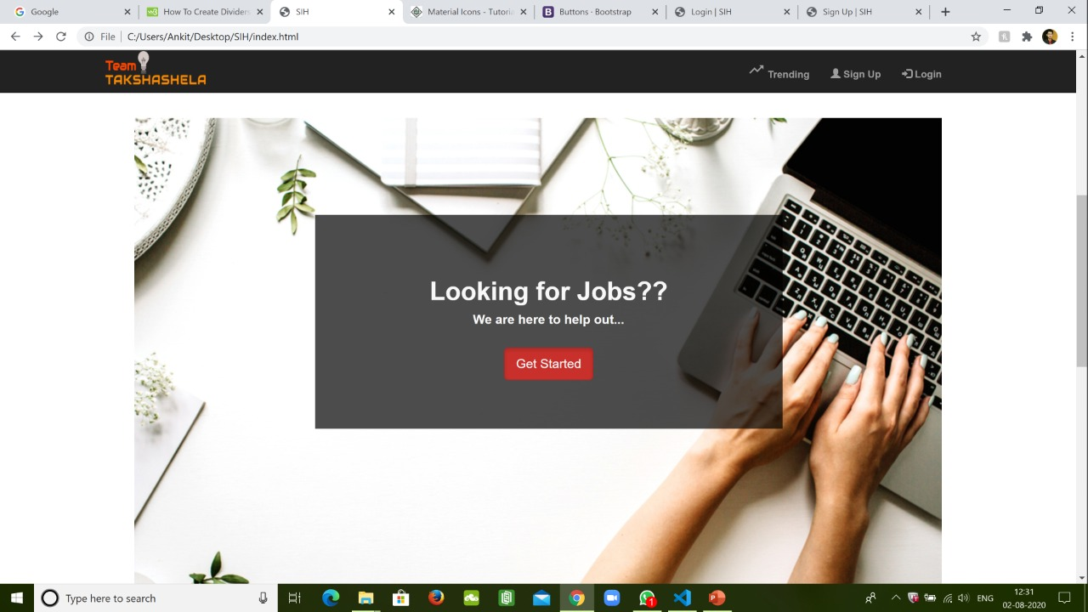
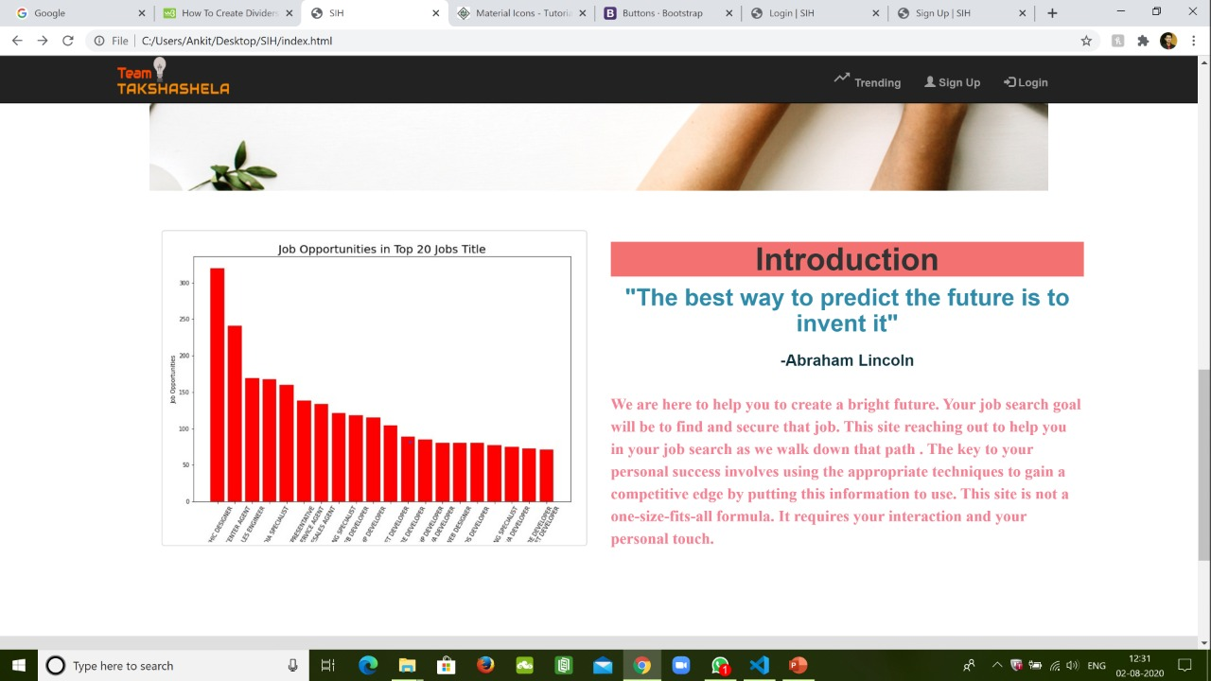
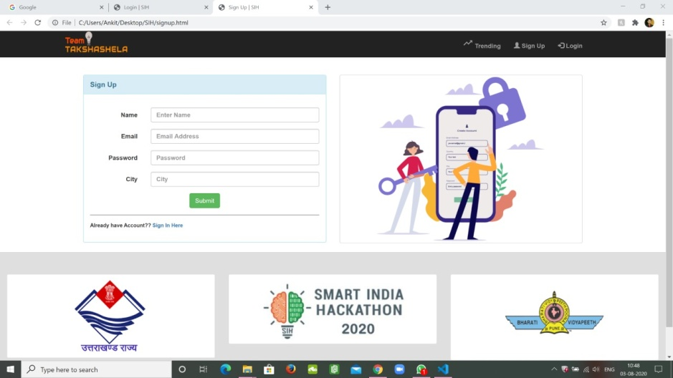
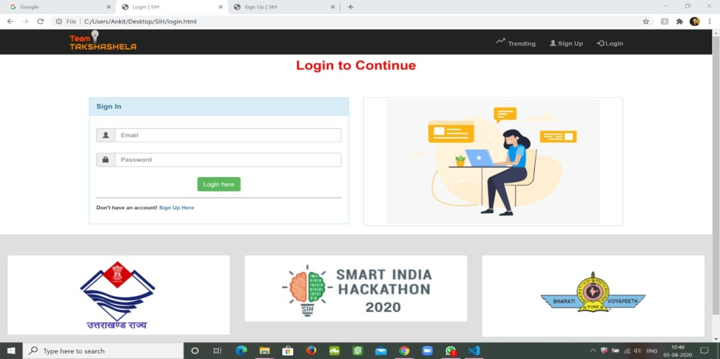

Slide 14
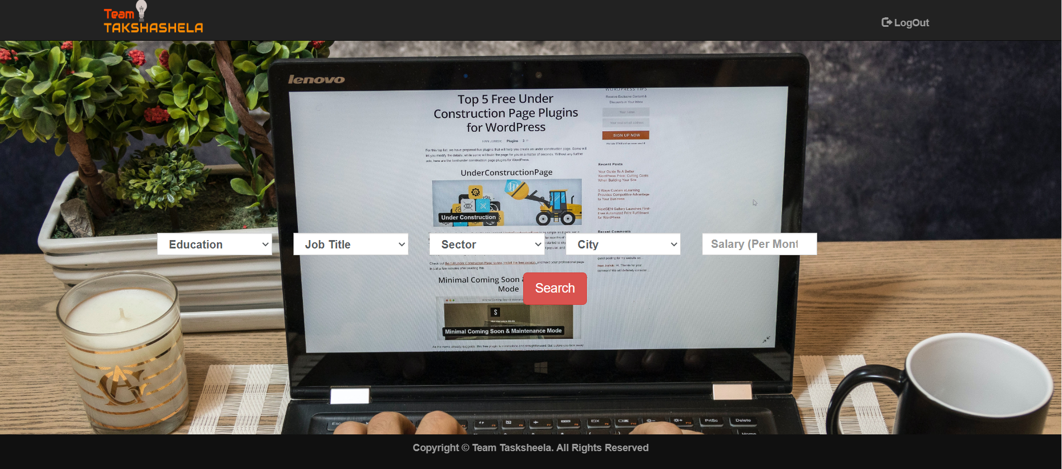

Slide 15
THANK YOU

